Slide 1

Mushroom Classification: Predicting Edibility Using Machine Learning
A Machine Learning Approach for Safe Mushroom Identification
Abhishek Kapadia : 39295308
Rohith Kumar Reddipogula : 83435165
Amrutha doddasarangi Suresh : 31194310

Slide 2
Why Is This Problem Important?
The Danger of Mushroom Foraging
The Role of Machine Learning
Many mushrooms look alike, but some are poisonous.
Can we build a model to classify mushrooms as Edible or Poisonous?
Incorrect identification can lead to severe health risks.

Slide 3
UCI Mushroom Dataset
Source
Total Samples
UCI Machine Learning Repository
8,124
Features
Target Variable
22 categorical attributes (cap shape, odor, gill size, etc.)
Edible ("e") or Poisonous ("p")

Slide 4

Machine Learning Models Used
Baseline ModelLogistic Regression
Advanced ModelsRandom Forest (ensemble learning for high accuracy), Support Vector Machine (SVM) (strong classification for complex data), Neural Networks (MLP) (deep learning for pattern recognition)
Model SelectionBalance interpretability, performance, and complexity.

Slide 5
How Do We Measure Success?
Metric
Description
Accuracy
Overall correctness of classification.
Precision
Proportion of correctly identified poisonous mushrooms among those classified as poisonous.
Recall
Proportion of correctly identified poisonous mushrooms among all actual poisonous mushrooms.
F1-Score
Harmonic mean of precision and recall, balancing both metrics.
Cross-Validation
Technique to ensure the model's performance is consistent across different subsets of the data.

Slide 6
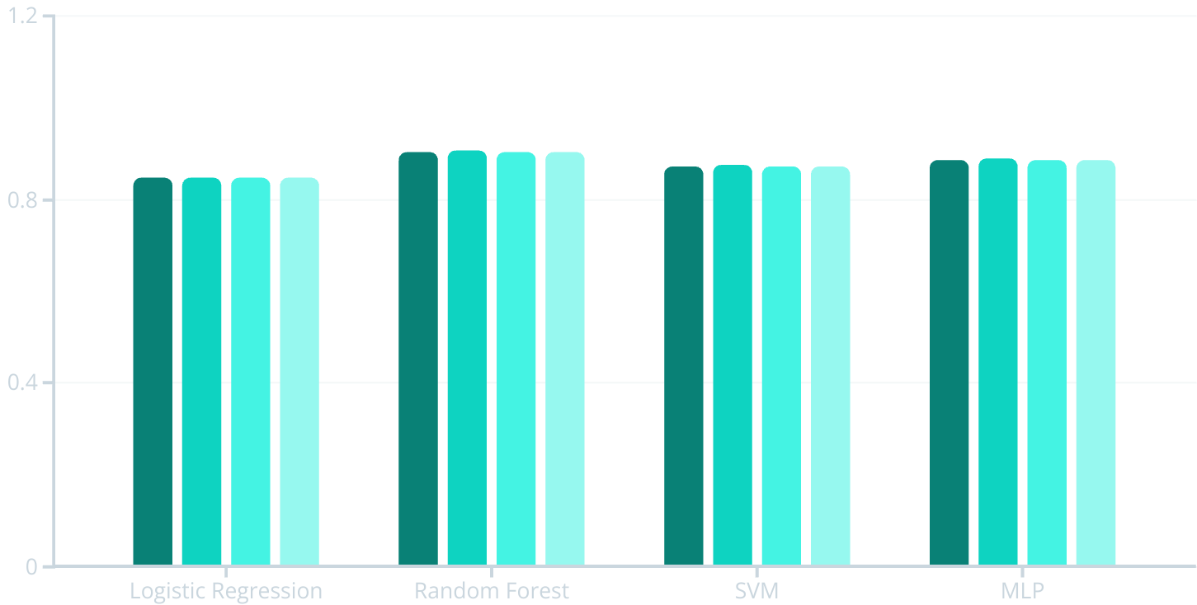
Model Performance Comparison
Accuracy
Precision
Recall
F1-Score

